Slide 1

Agentic AI Builder: Low-Code AI Agents & Voice Agents in n8n
Week 3
Day 3

Slide 2
3 Weeks to Agentic AI Builder
Core skills
Integrations
Projects
Week 3: Amplify with multi-agent systems and MCP
Self-hosted n8n and Local LLMs
Advanced Integrations
MCP
Context Engineering, Sub-Agents
Capstone: Amplify your business
Week 2: Accelerate with Voice Agents and RAG
Voice Agents with ElevenLabs
Integrating ElevenLabs and n8n
RAG and Agentic RAG
Supabase Vectors and Data ingest
Product Expert Voice Agent
Week 1: Automate with workflows in n8n cloud
First n8n AI Agent Live
Foundations: Agentic AI and n8n
Integrations with docs and email
Data and integrations
Daily Portfolio Rebalancer

Slide 3
Setting the stage
The major innovation
behind Agentic AI
..is not MCP!
It is tools.
Or, the idea that LLMs can generate tokens to describe which tool to use, based on what a tool does.
There’s a ton of hype around MCP,
and some of it is warranted and some is misplaced -
the hype should be around tools.

Slide 4
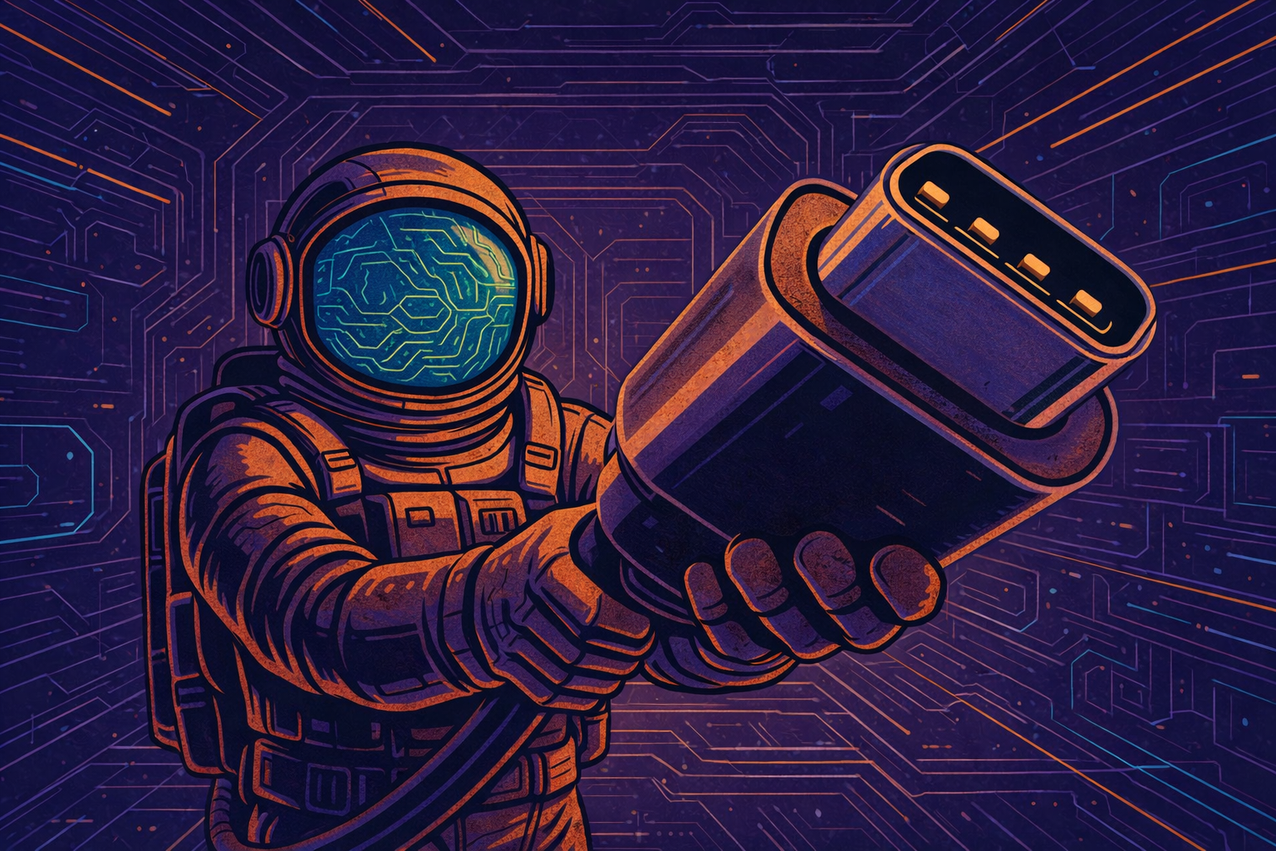
So, what is MCP?
Model Context Protocol from Anthropic
“The usb-c port for AI applications”
“an open-source standard for connecting AI applications to external systems”

Slide 5
In practice:
Easy way to use Tools written by someone else
Easy way to share your Tools with others
Easy way to connect LLMs with Tools
The game-changer is the ADOPTION
It’s the interface, not the tools themselves
It’s an agreed standard, not major innovation
Still might be ‘passing fad’ - there are new evolving ways to integrate LLMs with Tools like Skills and Code Mode

Slide 6
Technicality 1
3 pieces of the puzzle
MCP Host
Like,
Claude
AI App
n8n
MCP Client
MCP Server
MCP Client
MCP Server
MCP Client
MCP Server

Slide 7
Technicality 2
3 transport mechanisms
stdio - MCP server runs on your computer
sse - a legacy approach now deprecated
Streamable HTTP - the updated version
MCP Host
MCP Client
MCP Server
MCP Client
MCP Server
MCP Client
MCP Server

Slide 8
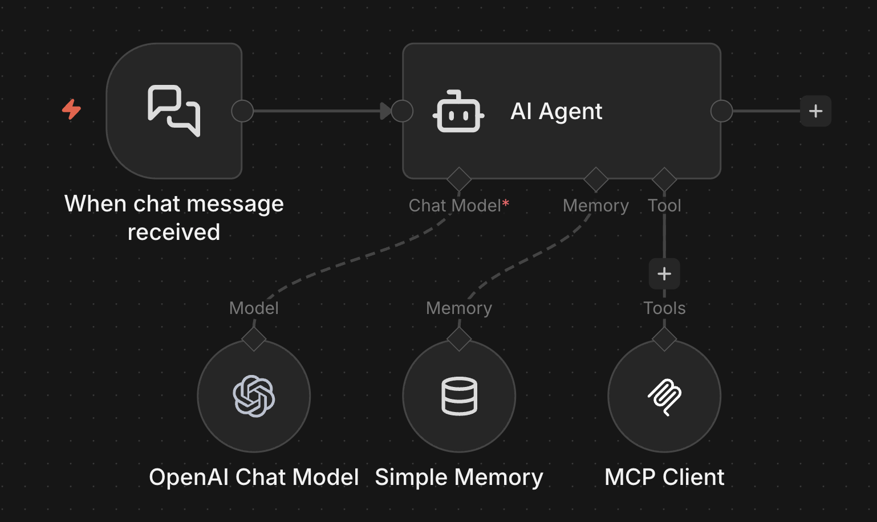
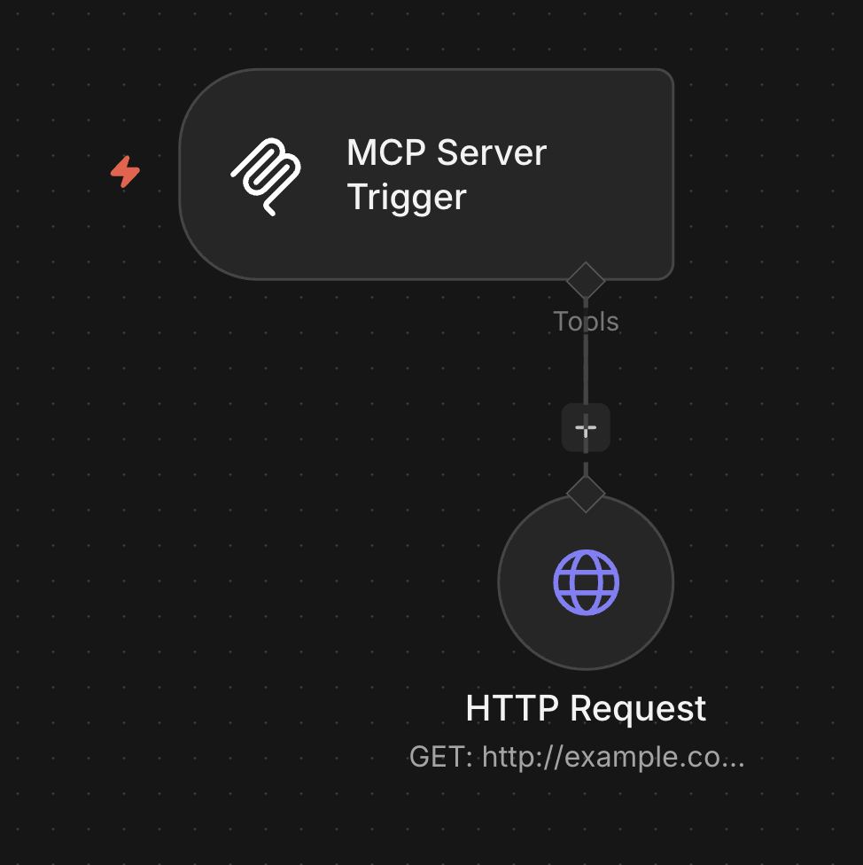
3 ways to use MCP with n8n
An MCP Client node to use someone else’s tool
An MCP Server Trigger to share your workflow as a tool
Instance-level MCP: A global setting to give
MCP access to workflows in an n8n instance

Slide 9
MCP isn’t as common with n8n
1
n8n doesn’t support stdio / local MCP
2
n8n already has off-the-shelf Tool Nodes for so many major integrations!

Slide 10
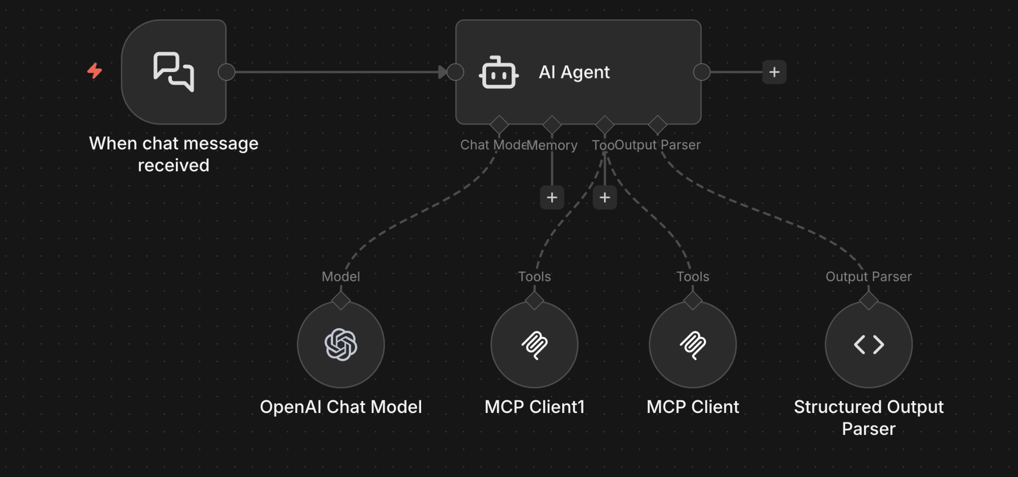
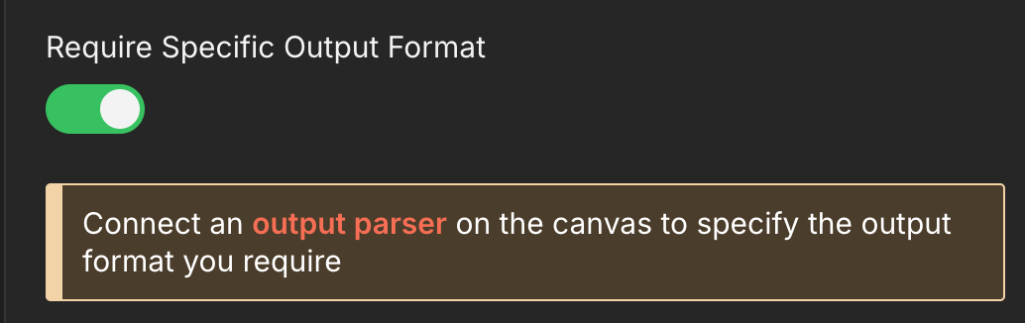
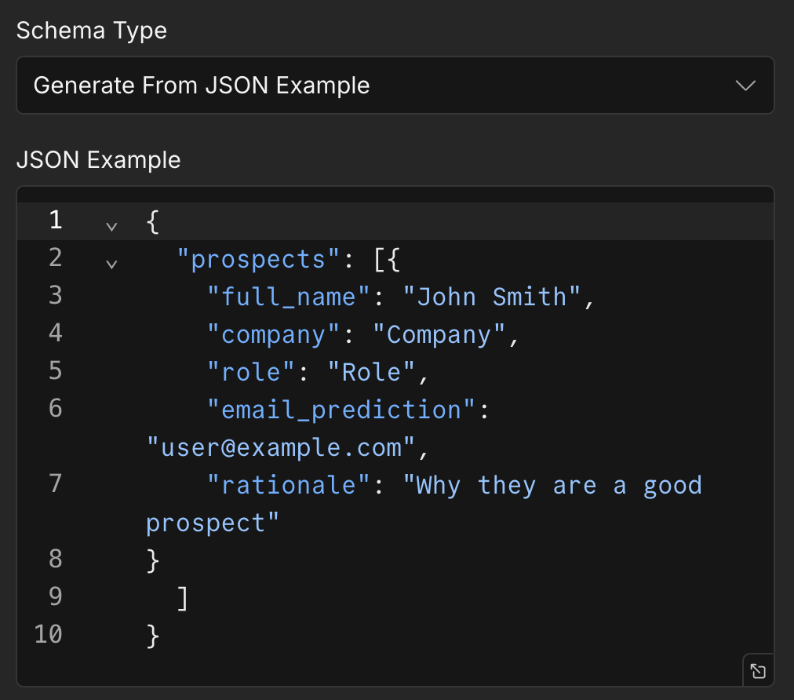
The powerful feature we used last time:
Structured Outputs

Slide 11
3 Weeks to Agentic AI Builder
Core skills
Integrations
Projects
Week 3: Amplify with multi-agent systems and MCP
Self-hosted n8n and Local LLMs
Advanced Integrations
MCP
Context Engineering, Sub-Agents
Capstone: Amplify your business
Week 2: Accelerate with Voice Agents and RAG
Voice Agents with ElevenLabs
Integrating ElevenLabs and n8n
RAG and Agentic RAG
Supabase Vectors and Data ingest
Product Expert Voice Agent
Week 1: Automate with workflows in n8n cloud
First n8n AI Agent Live
Foundations: Agentic AI and n8n
Integrations with docs and email
Data and integrations
Daily Portfolio Rebalancer

Slide 12
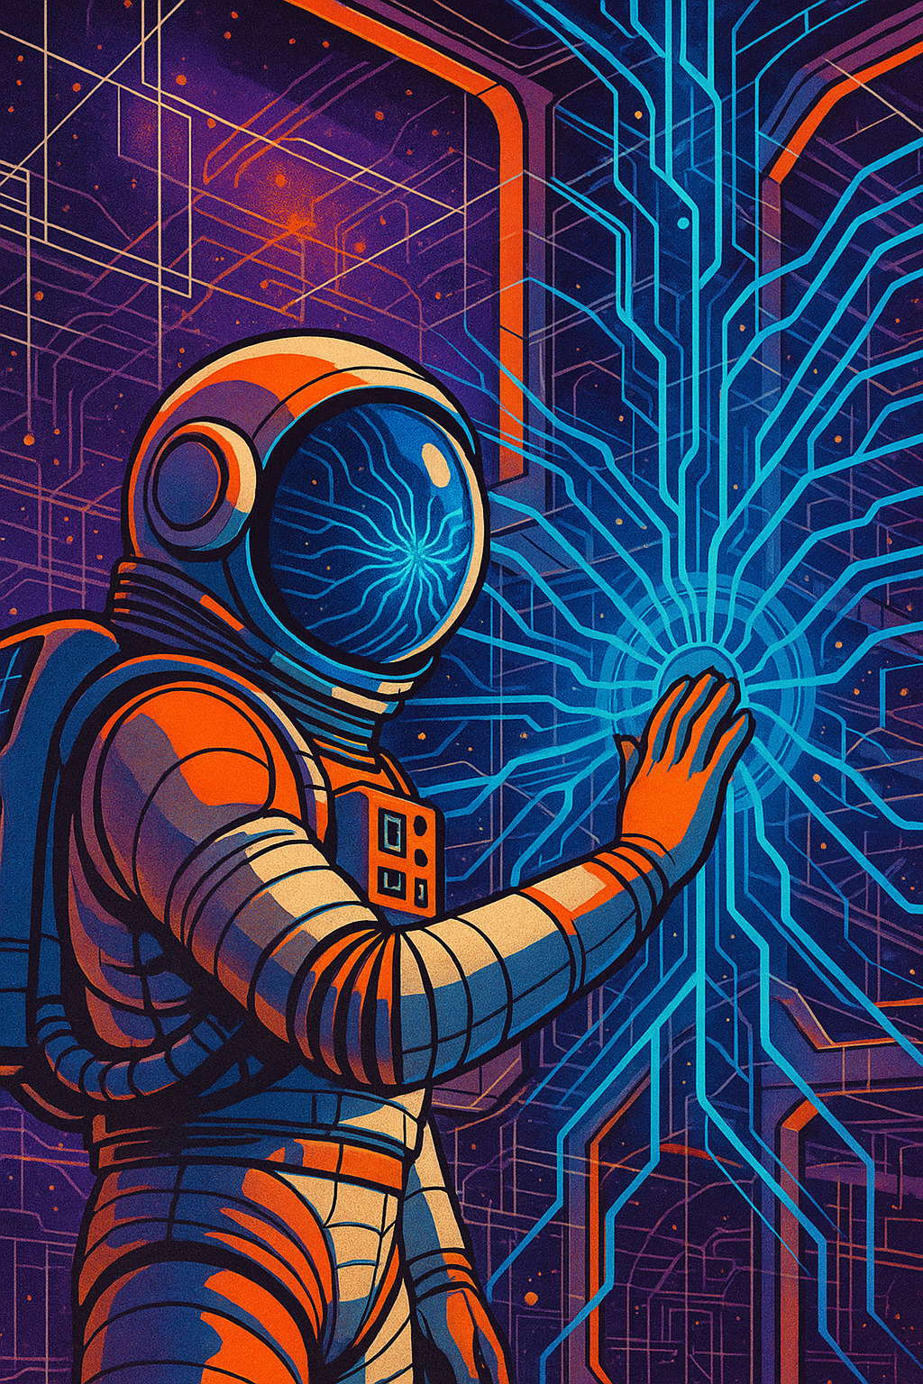
Agentic AI Builder: Low-Code AI Agents & Voice Agents in n8n
87%
Complete

